Slide 1
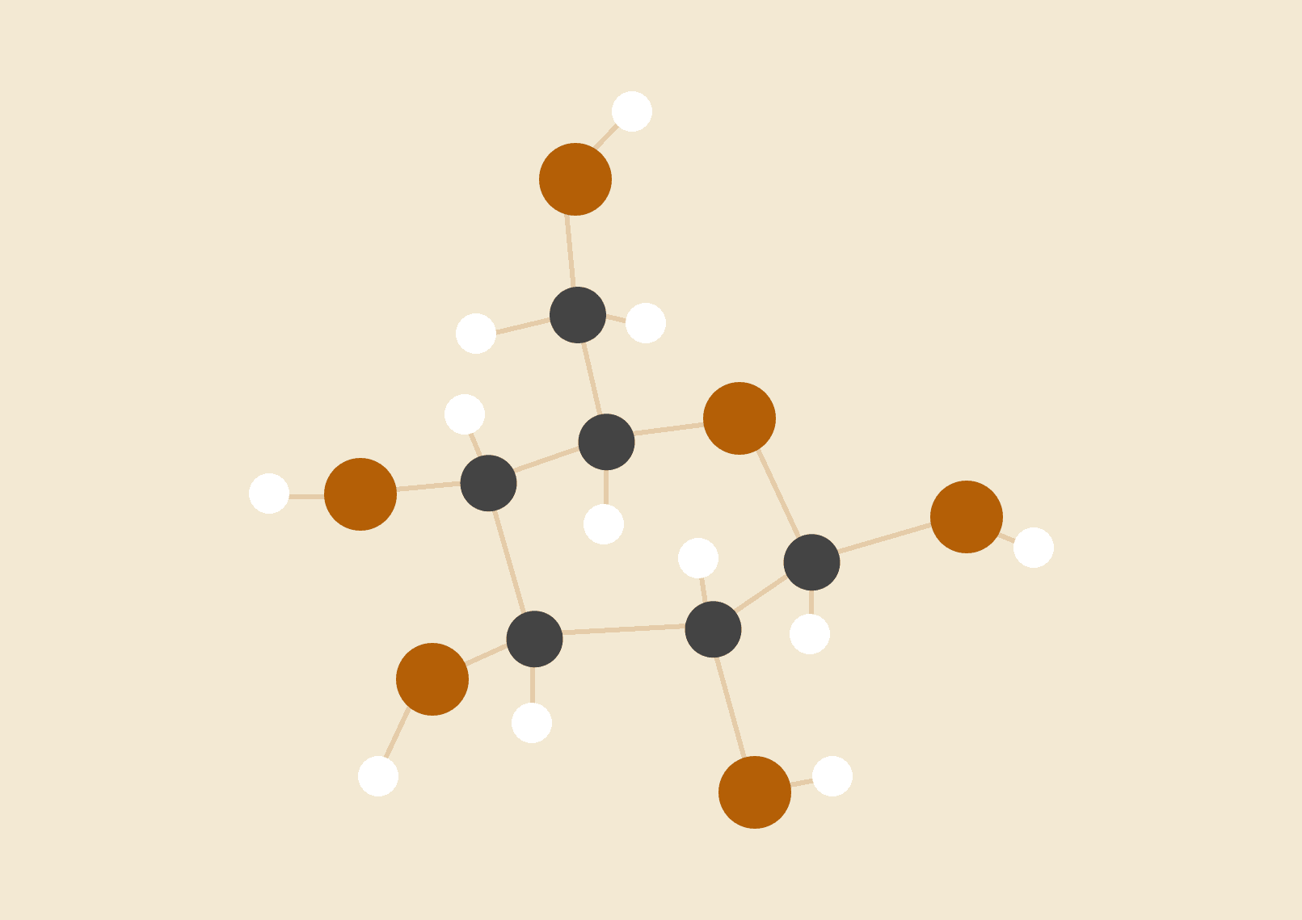
Prediction of Auto Insurance claims using Machine Learning techniques
Vector Institute
ML B&I Capstone Presentation
Valentine Udeh & Jean Paul Ngezigihe

Slide 2
Agenda
01
Introduction
Problem definition
Data exploration and description
Model
Results and findings
Conclusions
AI
02
03
04
05
06

Slide 3
Introduction
Auto insurance
Rise in Auto insurance claims and impact on insurance companies
Machine learning technique as a sustainable approach
Previous ML studies and research gap
Objective of the study
Brief description of the dataset

Slide 4
Data exploration
Table 1: Descriptive statistics of some of the numeric variables in the dataset
 | Customer Lifetime Value | Income | Monthly Premium Auto | Months Since Last Claim | Months Since Policy Inception | Number of Open Complaints
count | 9134 | 9134.00 | 9134.00 | 9134.00 | 9134.00 | 9134.00
mean | 8004.940 | 37657.38 | 93.22 | 15.10 | 48.06 | 0.38
std | 6870.968 | 30379.90 | 34.41 | 10.07 | 27.91 | 0.91
min | 1898.008 | 0.00 | 61.00 | 0.00 | 0.00 | 0.00
25% | 3994.252 | 0.00 | 68.00 | 6.00 | 24.00 | 0.00
50% | 5780.182 | 33889.50 | 83.00 | 14.00 | 48.00 | 0.00
75% | 8962.167 | 62320.00 | 109.00 | 23.00 | 71.00 | 0.00
max | 83325.381 | 99981.00 | 298.00 | 35.00 | 99.00 | 5.00
Notes:
Understanding our dataset is a crucial step in answering our study goal

Slide 5

Data cleaning
Checked for missing values : 0 missing values → No actions
Checked for duplicated rows: but 163 duplicated rows → Removed

Slide 6
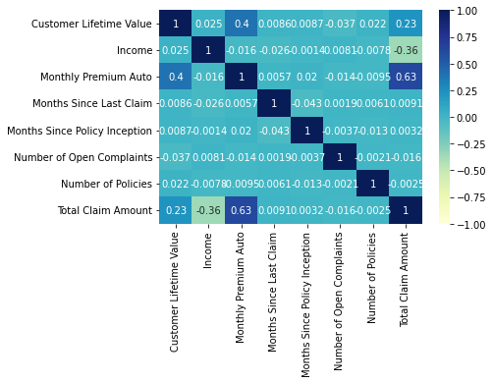
Data Visualization
Correlation Heat Map

Slide 7
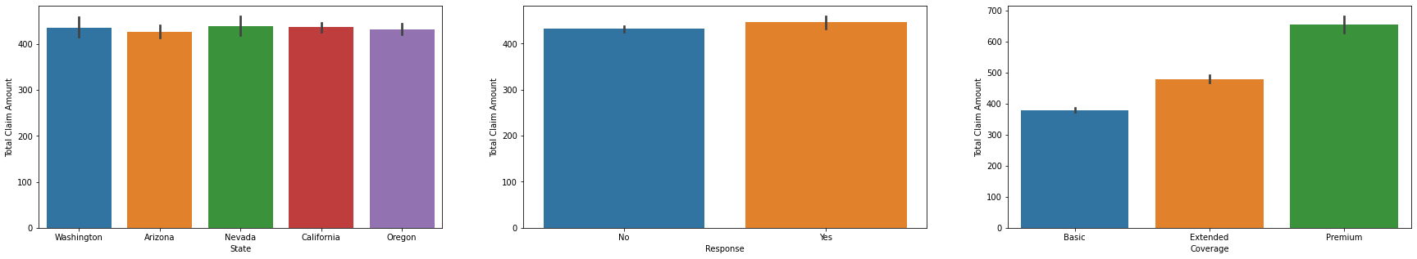
Data Visualization
Plotting the relationship between the independent variables (State, Response, Coverage, Education,etc…and the dependent/target variable (Total Claim Amount)
Notes:
Here are some examples

Slide 8
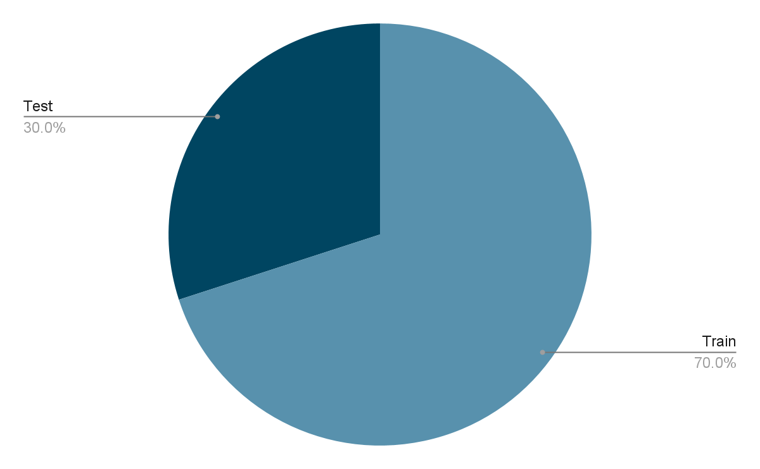
Data Preprocessing
Feature encoding
Some of the features are non-numeric, we must transform them via feature encoding, since we wish to use a regression model. We will be using a simple label encoder that turns the target labels to values between 0 and n_labelclasses - 1.
Data splitting
Notes:
Here are some examples

Slide 9
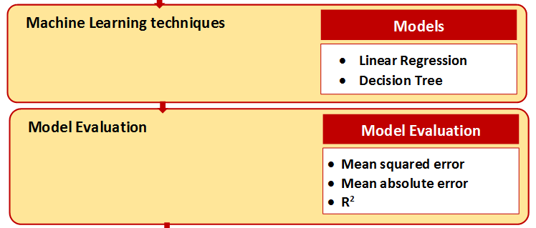
Model
LinearRegression()
DecisionTreeRegressor()

Slide 10
Results and findings
Table 2: Evaluation metrics of the models
Metrics | Linear Regression | Decision Tree Regression
Mean squared error (MSE) | 54.604 | 32.531
Mean absolute error (MAE | 5.805 | 4.393
Coefficient of determination R² | 0.609 (61%) | 0.767 (77%)

Slide 11
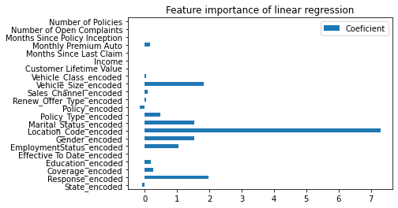
Feature importance - Regression model

Slide 12



Results and findings
Our model can explain 77% of the variance in the data between predicted values and true values
Insurance companies can use it in tandem with existing processes
Many business application: Predict cash flows, New insurance products, Segment customers
Ethical considerations
Explanabibility
Fairness
Notes:
Given its context, model is not accurate enough to for example accept/deny insurance claim based on this model.
.
Because our model is not opaque, may be possible to use it

Slide 13

Conclusions
Our model performed better on a non-linear model
Further business decisions on customers can be taken to can be taken from our model
Future works
Ethical framework techniques
Explanabibility → partial dependence plots
Fairness → subpopulation analysis

Slide 14
Q & A

Slide 15
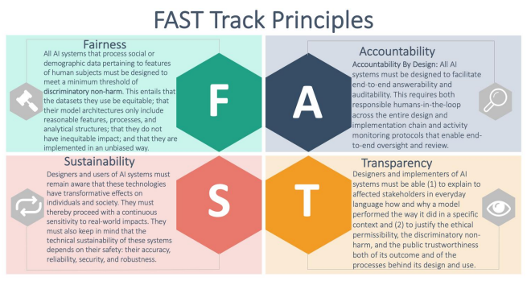
Appendix 1: Ethical AI framework
Alain Turin Institute: FAST TRACK Principles
Source

